Slide 1
Bayesian Inversion Solution for Source Term Identification for Scalar Transport
Sen Wang
Class Project Presentation

Slide 2
Motivation
Environmental Monitoring
Unpredicted Release of Toxic Chemicals
Explosion of Laboratories
Terrorist Attacks

Slide 3
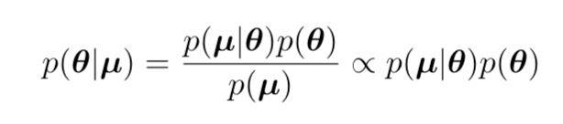

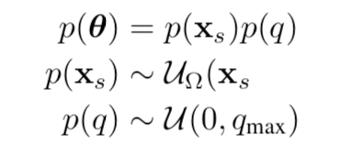

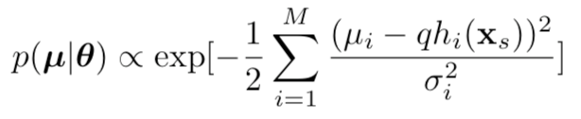
Bayesian Framework
Source Parameters
Likelihood
Prior

Slide 4
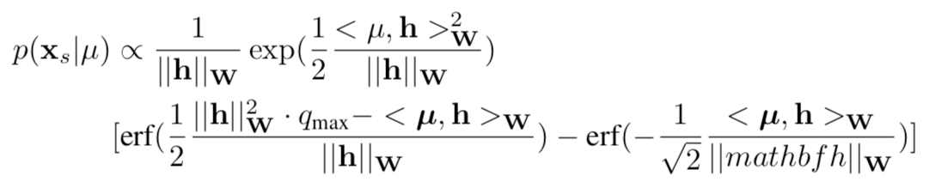
Marginal Posterior of Source Location
Because of independence of location and strength

Slide 5
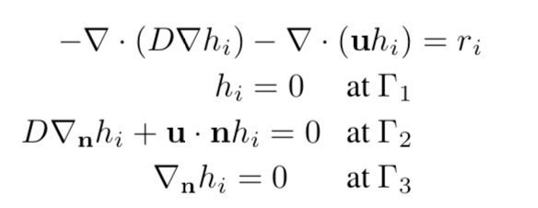
Source-receptor relationship

Slide 6
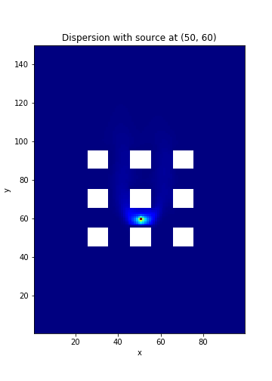
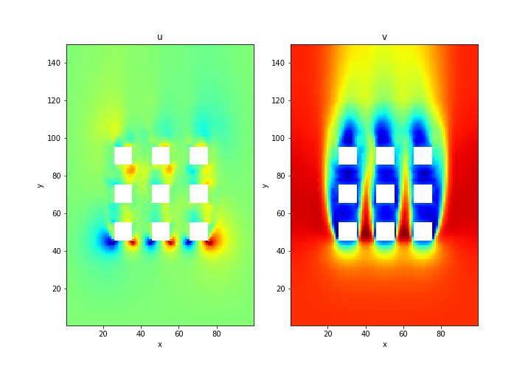
Flow Field and Dispersion Case

Slide 7
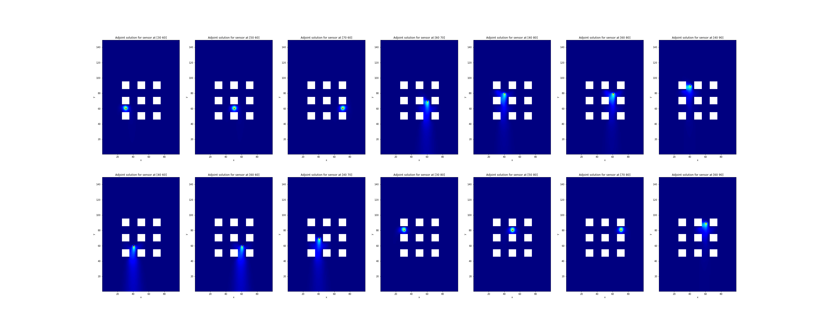
Computed Source-Receptor Relationship

Slide 8
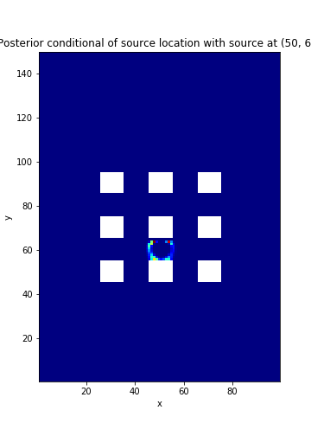
Marginal Posterior of Source Location
True Location
Xs = (50,60)
Inferred Source Location
Xs’ = (49.487, 59.400)

Slide 9
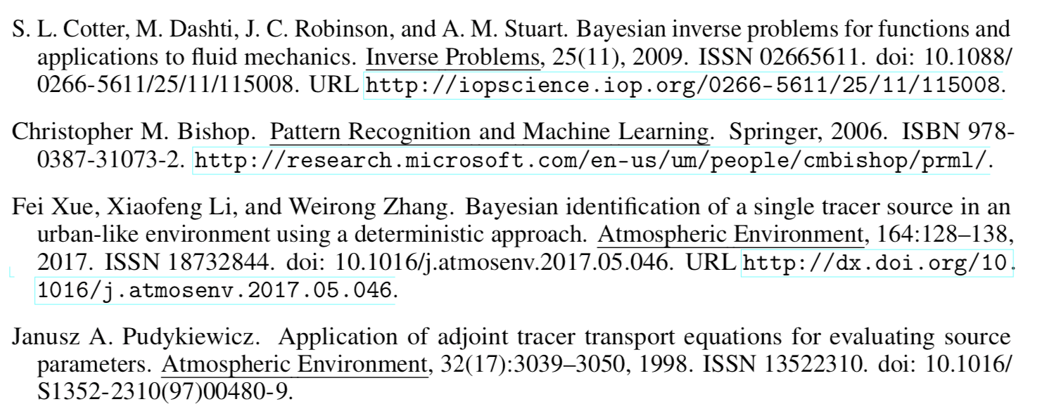
References

